Slide 1

Corvinus University of Budapest
Faculty of Economics
Analysis of World Happiness Report
Data Analysis
Group 3
Presented by: Wang Ke, Xiong Zijian
29th October 2021

Slide 2
Content
01
Introduction
02
Dataset Description
03
Analysis
04
Conclusions
02

Slide 3
Introduction
110 observations (Includes outliers)
Variables:
Continent
Dev
HappyScore
GDP
Satisfaction
Income
IncomeInequality
qualitative variables
quantitative variables
03

Slide 4
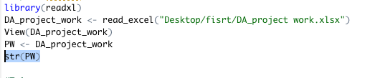
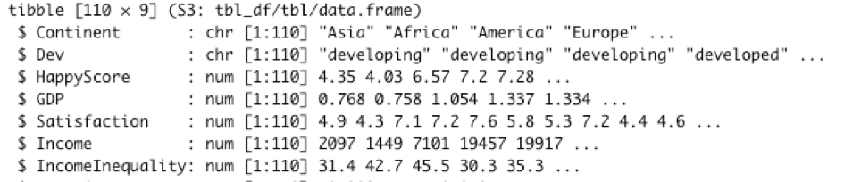
Introduction
We are able to use functions in R directly to check all the data type
Scale of measurement :
“Continent ” and “Dev” are nominal.
“HappyScore”, “GDP”, “Satisfaction”, “Income”, and “IncomeInequality” are ratio scale of measurement.
04

Slide 5
Issue of missing data , imputation, outlier, etc
We did not find some values like zero values, NA values, and so on.
However, for the outliers, the basic test for it should be done.
How to find that?
Find the huge difference between the mean and trimmed.
05

Slide 6
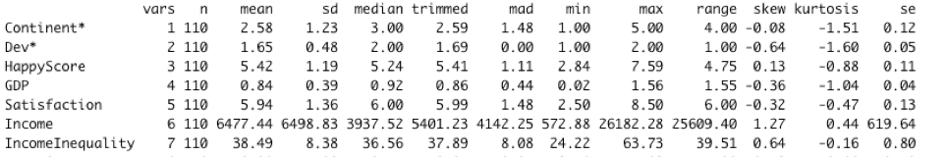
Issue of missing data , imputation, outlier, etc
We found there is a big difference mean and trimmed in variable Income in Table 2. In more detail, the mean of Income is 6477.44 and the trimmed of it is 5401.23. Thus, there must be one or more outliers in the variable “Income”.
06

Slide 7
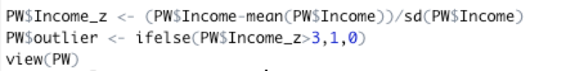
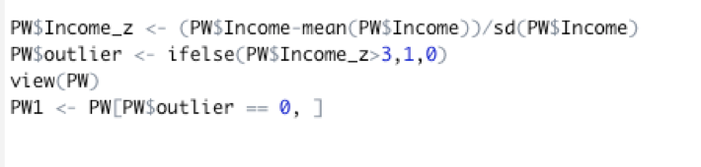
Issue of missing data , imputation, outlier, etc
After cleaning the outlier, we have 109 observations in our dataset.
07

Slide 8
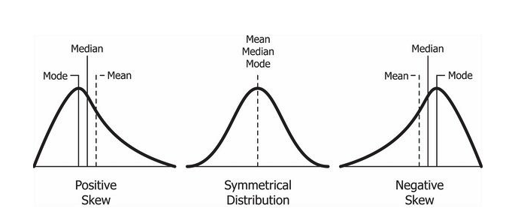
Descriptive statistics for numeric variables
Skewness and kurtosis
08

Slide 9
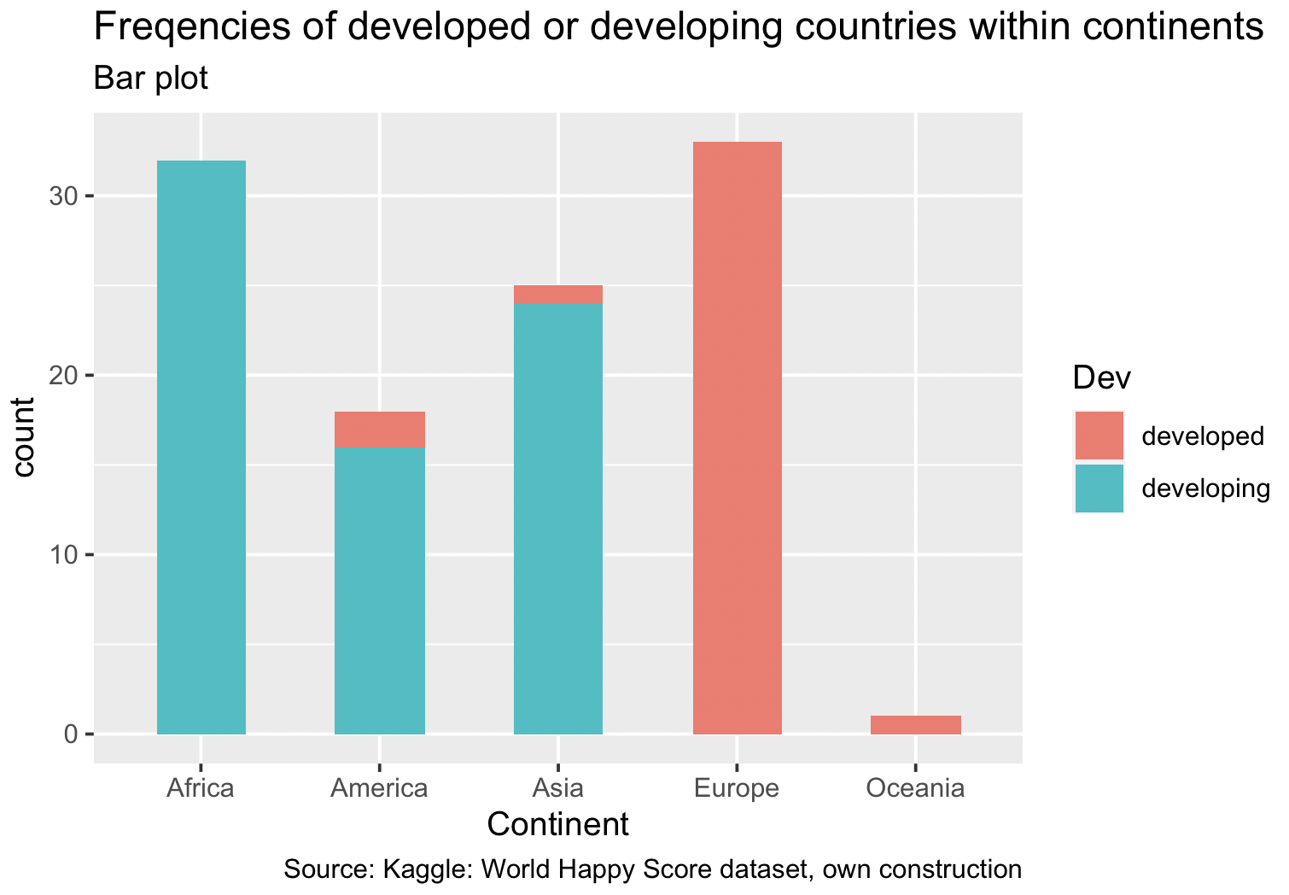
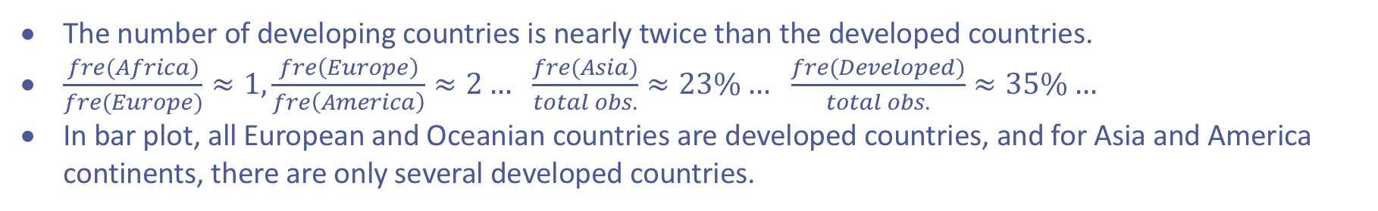
Analysis: ratios, frequencies and figures for qualitative variables
Frequencies of “Continent” variable | Frequencies of “Continent” variable
Group | Africa | America | Asia | Europe | Oceania
Frequency | 32 | 18 | 25 | 33 | 1
Frequencies of “degree of development of a country” variable | Frequencies of “degree of development of a country” variable
Group | Developed countries | Developing countries
Frequency | 38 | 72
Table: frequency tables of two qualitative variables
Graph: frequencies of developed or developing within continents (bar plot)
The number of developing countries is nearly twice than the developed countries.
$\frac{fre(Africa)}{fre(Europe)}≈1, \frac{fre\left(Europe\right)}{fre\left(America\right)}≈2…$ $\frac{fre(Asia)}{total obs.}≈23\%…$ $\frac{fre(Developed)}{total obs.}≈35\%…$
In bar plot, all European and Oceanian countries are developed countries, and for Asia and America continents, there are only several developed countries.
09

Slide 10
Analysis: confidence interval estimation
For “GDP” variable (normal distribution):
$$\overline{y}=the mean of GDP growth rate=0.836$$
$$margin of error= Z_{α/2}\frac{σ}{\sqrt{n}}=0.0723 (here we use 5\% confidence level)$$
$$upper limit bound=\overline{y}+margin of error=0.836+0.0723=0.908$$
$$lower limit bound=\overline{y}−margin of error=0.836−0.0723=0.763$$
The mean value of “GDP” variable is in the confidence interval.
We are 95% confident that the average GDP growth rate is between 0.763% and 0.908%.
For “Income” variable (normal distribution):
$$\overline{y}=the mean of annual income per capita=6296.662$$
$$margin of error= Z_{α/2}\frac{σ}{\sqrt{n}}=1172.341 (here we use 5\% confidence level)$$
$$upper limit bound=\overline{y}+margin of error=6296.662+1172.341=7469.003$$
$$lower limit bound=\overline{y}−margin of error=6296.662−1172.341=5124.321$$
10
The mean value of “Income” variable is in the confidence interval.
We are 95% confident that the average annual income per capita is between 5124.321 $ and 7469.003$.

Slide 11
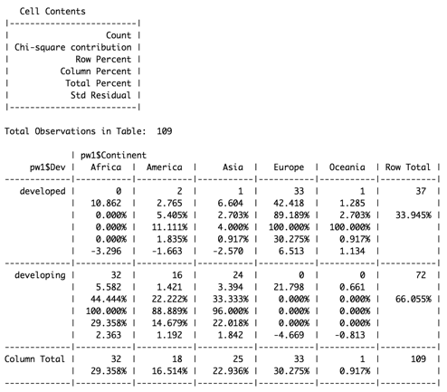
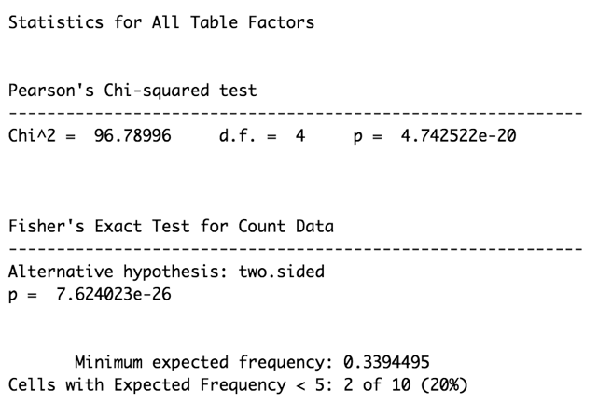
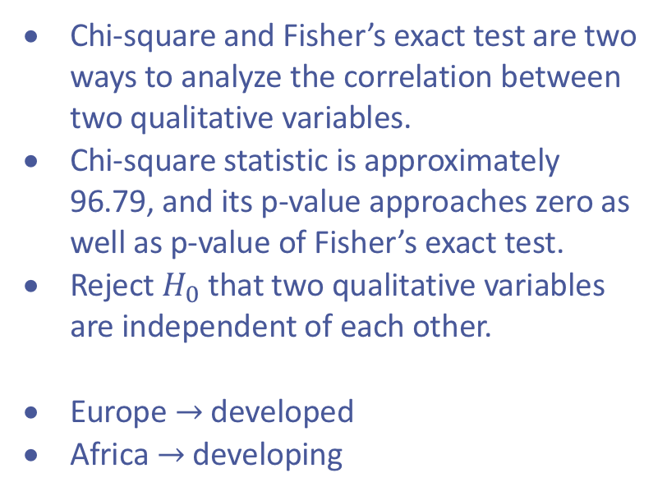
Analysis: cross table
Chi-square and Fisher’s exact test are two ways to analyze the correlation between two qualitative variables.
Chi-square statistic is approximately 96.79, and its p-value approaches zero as well as p-value of Fisher’s exact test.
Reject $H_{0}$ that two qualitative variables are independent of each other.
Europe $→$ developed
Africa $→$ developing
11
Table: cross table between two qualitative variables

Slide 12
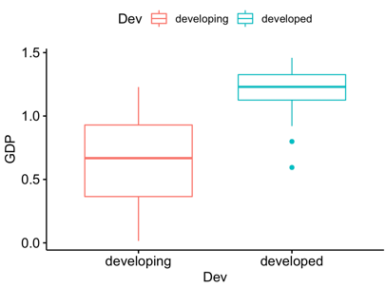
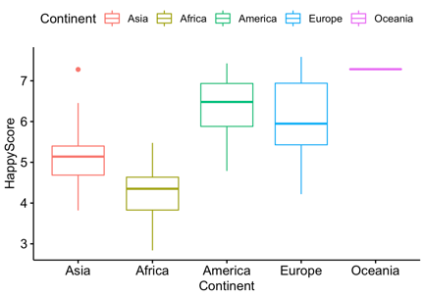
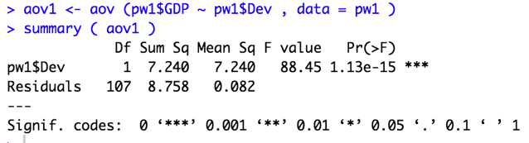
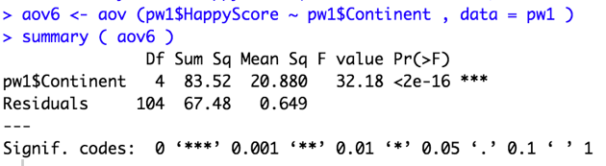
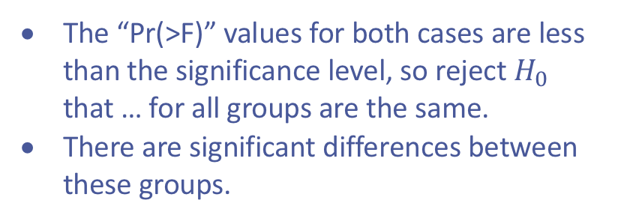
Analysis: ANOVA tables
If box plots for different groups seem identical, then they are likely to have very similar variances, or we can say there are no significant differences between groups.
In both boxplots, the range and interquartile range are different from each other, so there is a significant difference.
Graph: boxplots
The “Pr(>F)” values for both cases are less than the significance level, so reject $H_{0}$ that … for all groups are the same.
There are significant differences between these groups.
12
Table: ANOVA tables

Slide 13
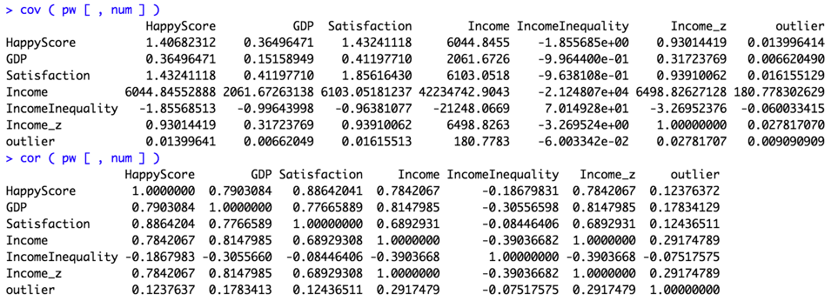
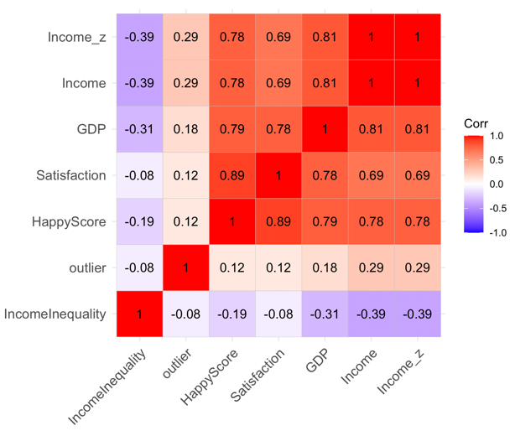
Analysis: covariance and correlation
Covariance is a measure of linear association between two quantitative variables.
Correlation is a measure of linear association and does not indicate causation. (heatmap)
Positive value indicates a positive relationship; negative value indicates a negative relationship.
Table: covariance matrix
Happiness score has positive relationship with GDP growth rate, the overall satisfaction towards the whole society, and income; Happiness score has negative relationship with income inequality.
13
Table: correlation heatmap

Slide 14
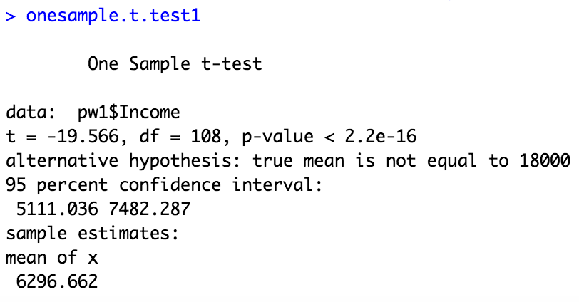
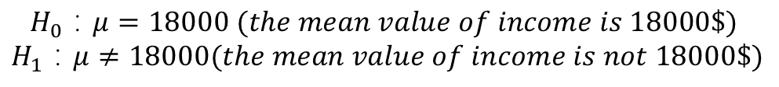
Analysis: hypothesis testing
mean test
$$H_{0}：μ=18000 (the mean value of income is 18000\$)$$
$$H_{1}：μ≠18000(the mean value of income is not 18000\$)$$
Hypothesis t-test for expected value of income
P-value approaches zero, thus we reject null hypothesis.
The actual sample estimates on annual income per capita is 6296.662 $.
14

Slide 15
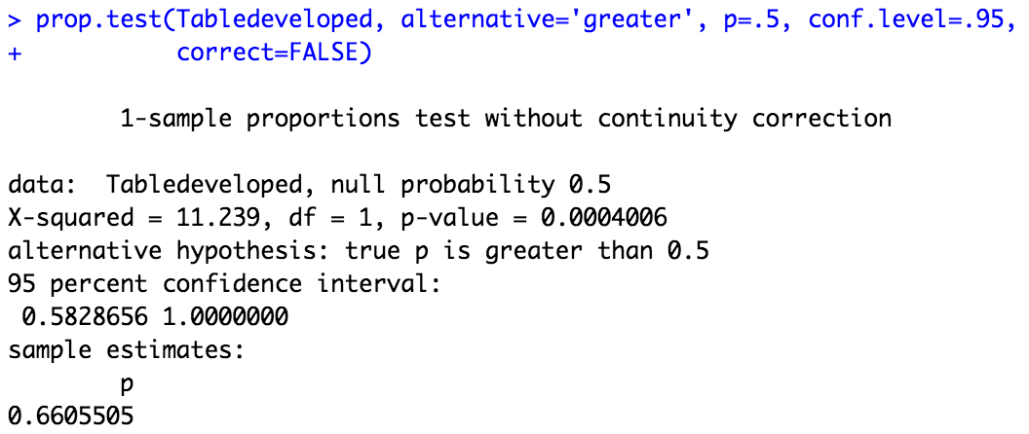
Analysis: hypothesis testing
proportion test
The expected proportion of developing countries should be 50% as well as the expected proportion of developed countries. We want to test whether this dataset satisfies theoretical proportion or not.
$$H_{0}：P=0.5 (the therotical proportion should be 50\%)$$
The p-value is less than 5%, which means we should reject null hypothesis. And we can get the actual sample estimates of proportion of developing countries is about 66.1%
15

Slide 16
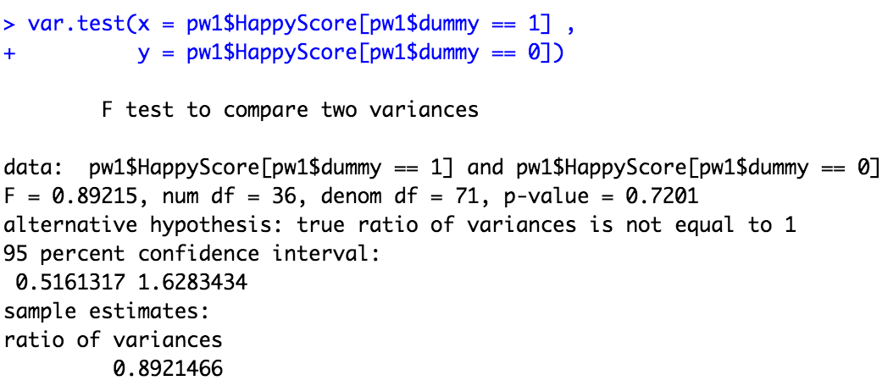
Analysis: hypothesis testing
Two sample variance test
Create dummy variables, if “developed” then it is 1, otherwise 0.
$$H_{0}：σ_{Y}=σ_{X}(two variances from the samples should be equal)$$
$$H_{1}：σ_{Y}≠σ_{X}$$
P-value is greater than 5%, thus we can not reject null hypothesis.
The actual sample estimated ratio of variances is 0.89.
16

Slide 17
Conclusions
In this project, we analyze 110 observations with 2 qualitative and 4 quantitative variables. data type, scale of measurement, unit of measurement, outlier issue, and descriptive statistics
Analysis of qualitative variables: ratios, frequencies, cross tables Analysis of one qualitative and one quantitative variables: ANOVA tables Analysis of quantitative variables: covariance and correlation
Confidence interval estimations Hypothesis testing including mean test, proportion test, and ratio test.
17

Slide 18
Thanks for your attention!

